Slide 1
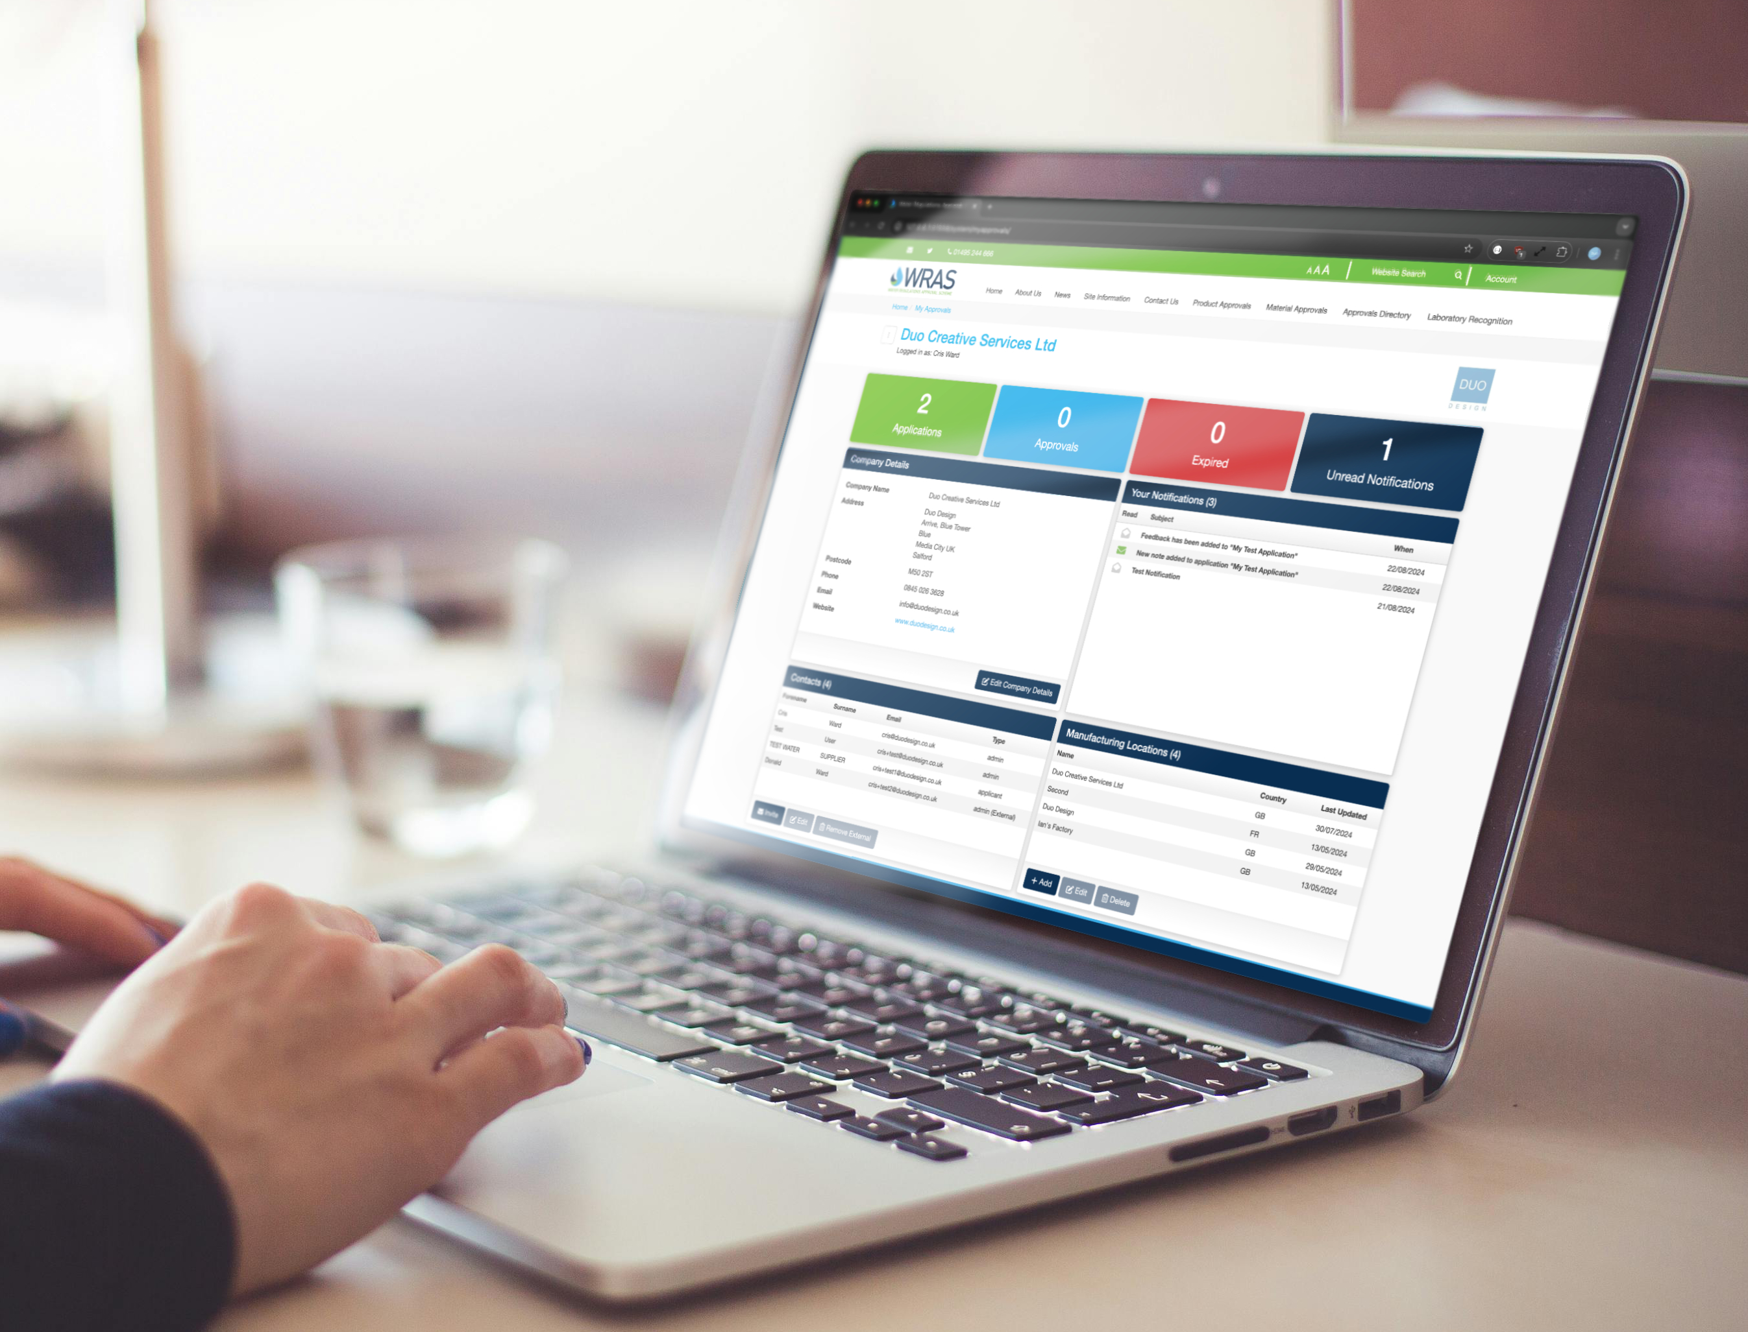


Online Portal & Submitting an Application

Slide 2
Contents
The Online Portal - Accessing your dashboard 03
Application Dashboard 04
My Applications 05
Product Overview 06
Product Details 07
Product Details - Direct Input 08
Product Details - Offline Upload 11
Manufacturing Locations 12
Documents 14
Schedule of Materials (SoM) 16
Complete Application 22
Application Review 23
My Approvals 27

Slide 3
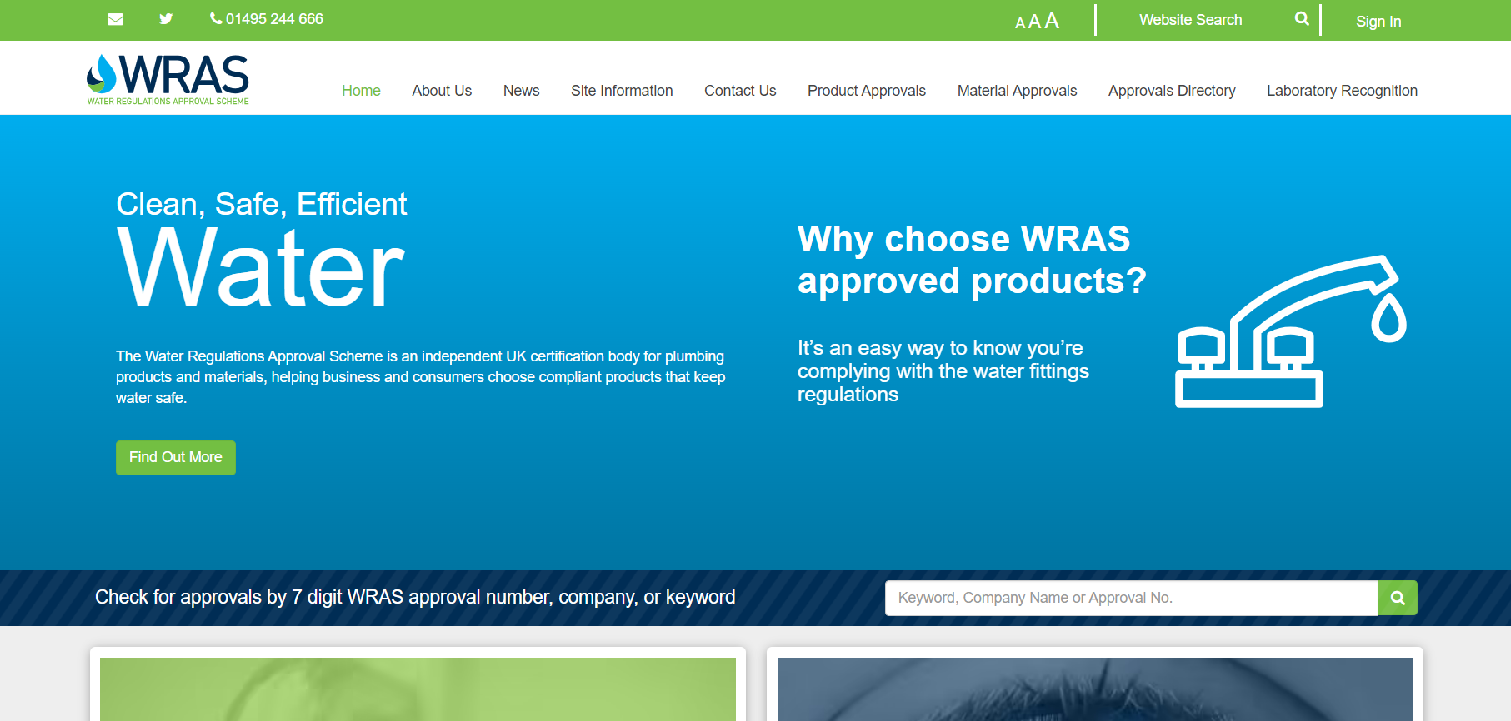
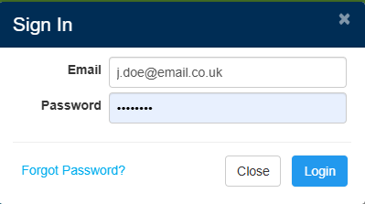
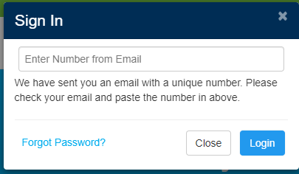
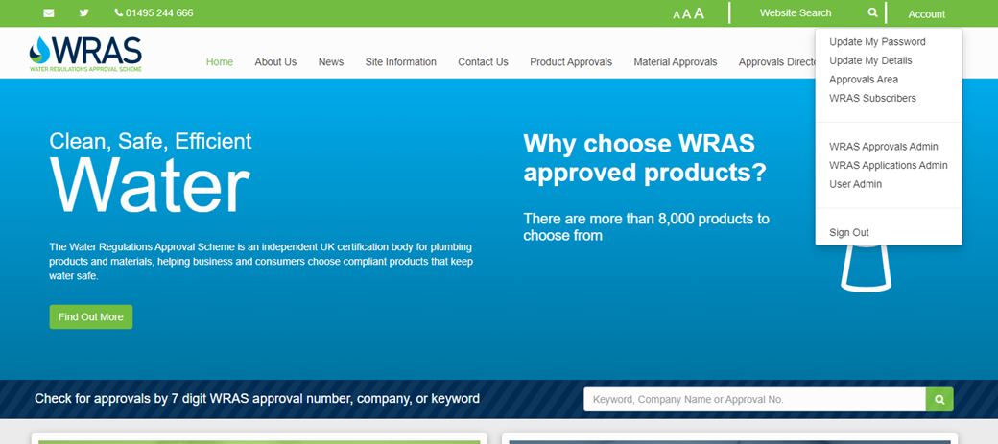
The Online Portal – Accessing Your Dashboard
1
Log In – Click ‘Sign In’ at the top of the page and enter your credentials.
Two-Factor Authentication – If logging in for the first time or from a new location, enter the code sent to your registered email.
Access Your Account – Click the ‘Account’ button at the top of the page.
Open Approvals Area – In the drop-down menu, select Approvals Area to access your Approvals Dashboard.
2
EMAIL EXAMPLE
We detected an attempt to access your Water Regulations Approval Scheme Ltd account (J.doe@email.co.uk) from a new location,
If this was you, please provide the below number as part of the login:
8573976
If this was not you, you should update your password on the Water Regulations Approval Scheme Ltd website.
4
3

Slide 4
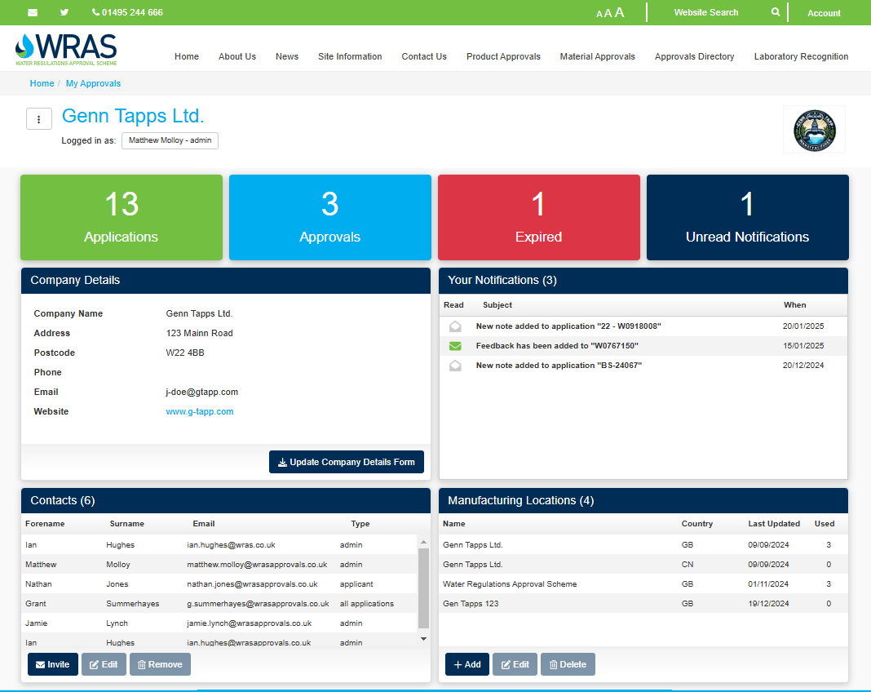
Approvals Dashboard
Key
Applications - View all application
Approvals - Access all the live approvals and approval documentation
Expired - View approvals that have expired in the previous six months
Unread Notifications - Count of unread notifications
Company Details - Details of company who will appear on the approval as approval holder.
Your Notifications - All messages from the approval system, including application comments and notifications regarding expiring approvals.
Contacts – all people who have access to the online portal for your company, Admins can edit this at any time.
Manufacturing Locations – All the manufacturing location the company uses on their approvals, click +Add button to add a new manufacturer.
1
2
3
4
5
6
Test App 2025
Test App 2025
Test App 2025
7
8
John
Doe
Jdoe@Email.co.uk
John
Doe
Jdoe@Email.co.uk
Jane
Doe
Jdoe@Email.co.uk
John
Doe
Jdoe@Email.co.uk
John
Doe
Jdoe@Email.co.uk
John
Doe
Jdoe@Email.co.uk

Slide 5
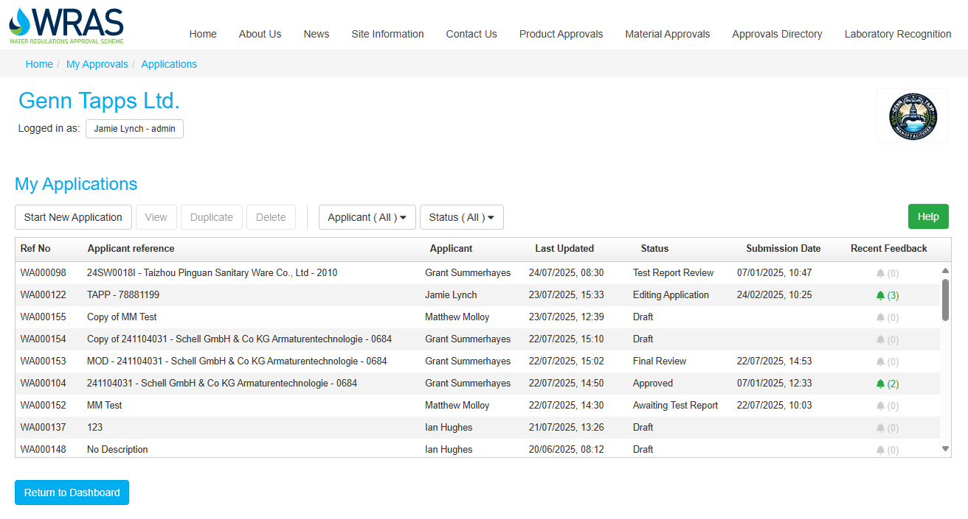
My Applications
Start New Application - Start a new direct application.
View - View the selected application.
Duplicate - Make a copy of the selected application.
Delete - Delete a ‘Draft’ version of a selected application. Once an application is submitted you will be unable to delete.
Ref No – The unique auto generated number to be used on all communication and documentation when discussing the application.
Applicant reference – Applicants internal identification which will be entered during application submission.
Recent Feedback – The green bell highlights messages in the application.
Status - The status of the application
    ‘Draft’ – Application has not been submitted.
    ‘Application Processing’ – WRAS is processing the application.
    ‘Editing Application’ – Comments made on the submission, applicant to review and re-submit once updated
    ‘Awaiting Sample & Test Report’ – Applicant to supply requested samples and submit the Test report from recognised laboratory.
    ‘Awaiting Sample & Test Report’ – Samples have been received applicant still to submit the Test report from recognised laboratory.
    ‘Test Report Review’ – WRAS is reviewing your Test report.
    ‘Final Review’ – Your application has been submitted for Final review
    ‘Approved’ – Application has been approved and linked to the approval.
Filter Buttons - Applicants can filter the between applicants and the status of applications
Help – Link to the ‘Application Help’ the guide to completing the fields in the application.
2
3
4
9
10
1
8
7
6
5

Slide 6
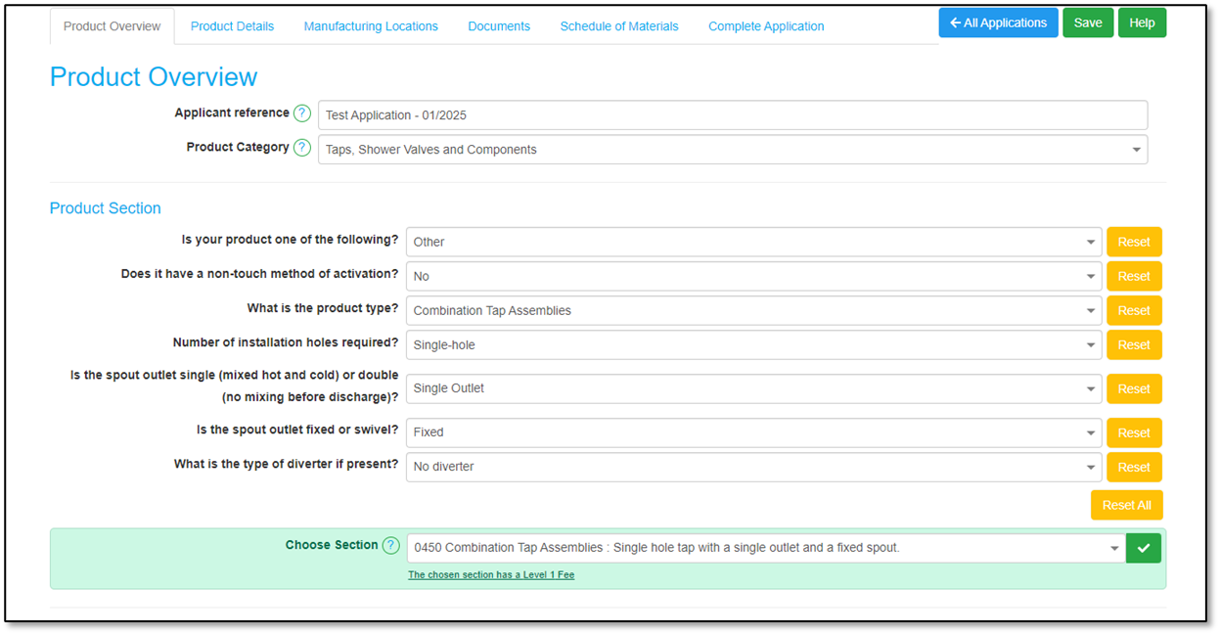
New Application – Product Overview
Complete the Following:
Applicant reference - Enter your unique application identification number. This can be your customer reference number, job number, or work order.
Product Category – Select the relevant category for your product. Currently, the only available category is "Taps, Shower Valves, and Components.".
  Further categories will be added over the next 2 to 3 years
Product Section - The Directory section of the WRAS website your product will be included in. Complete this in one of two ways.
Choose Section – Select the Section that represents your product from the list.
Product Section Selection Questions - answer the questions, if you are unsure which section your product belongs to, complete the product selection questions to aide you in choosing the correct Product Section.
? – Hyperlink to the online ‘Help Guide’.
1
2
3
5
6
4

Slide 7
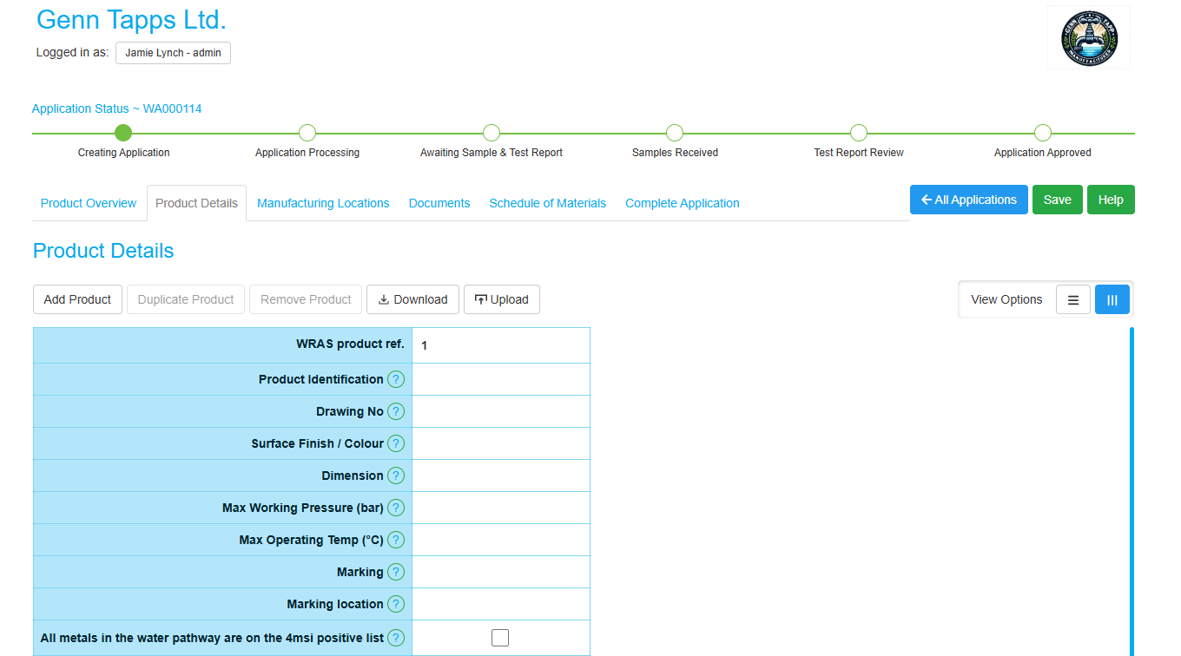
Product Details
Key
Add Product – Generates a new column to add the products to be listed on the approval.
Duplicate Product – Duplicate the product details of the adjacent product.
Remove Product – Delete any unwanted products added to the listing.
Download – Download an excel file to complete product details
Upload – Upload the excel file with completed product details, ensure the formatting stays the same or the file will be rejected.
View Options – Toggle between horizontal and vertical view of the product details.
1
2
3
4
5
6

Slide 8
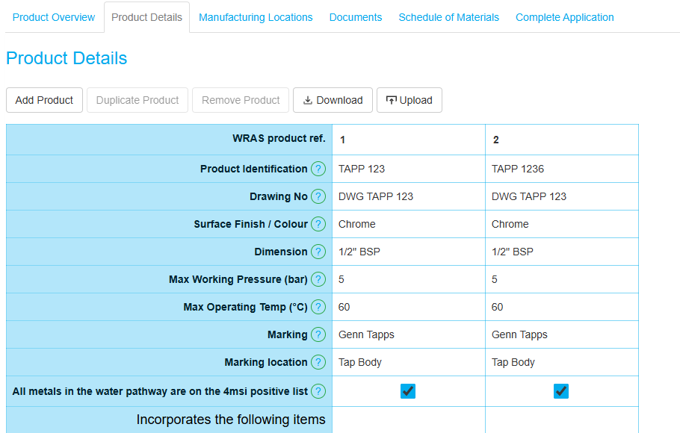
Product Details – Direct data input
For each product, the following MUST be completed:
Product Identification – Please input each model name or code. Each product in the model range(s), should have a unique, non-generic model name or model code (sometimes known as product code or Stock Keeping Unit [SKU] code). The Product code could have a suffix that relates to a variable property (for example a 3-digit code that represents colour or finish), in this instance it is permitted to replace the various codes with XXX where XXX is a colour reference. The detail for this should be recorded in the ‘Notes & Further Information’ located below the product details table.
Drawing No - Each drawing that is used to illustrate your product must have a unique drawing/reference number/name. Please insert this number/name. This should correspond to a Schedule of Materials (SoM) with the same number/name.
Surface Finish/Colour - If the model has a choice of surface finishes, such as chromium, matt black and so on, please detail this here. If various please write various and add more details in the notes and further information section below the table.
Dimension - Please detail the one of the following:
  inlet dimension and connection type for each model here. For example, 1/2" BSP (M), 15mm compression, 12mm push-fit.
  Specific model size for connection. For example, ‘DN’ or external diameter.
Max Working Pressure - Please specify the maximum pressure (in bar) at which the product has been designed to work. Please note, pressure testing will typically be conducted at higher pressures than the specified maximum working pressures.
Max Operating Temperature - Please specify the maximum temperature at which the product has been designed to operate. Please note, the maximum specified temperature of the product cannot typically be higher than any of the non-metallic materials/components listed in its corresponding SoM(s).
Marking - Every product seeking WRAS approval must be marked in an appropriate manner, to allow the product to be identified after installation. Please provide details of how the marking(s) look(s)’.
Marking Location - Please provide details of where the product identification marking(s) are located on the product. For example, 'body of tap' or 'operating member'. You can detail multiple locations if appropriate.
All metals in water pathway on 4MSI positive list? - Please confirm with a tick if completing online. If completing by using the download option type ‘yes’ or ‘true’. Leave the field blank if not all metallic materials are on the 4MSI positive list.
1
2
3
4
5
6
7
8
9
Top Tip
If products are similar, complete the details of the first product and then use the duplicate button.

Slide 9
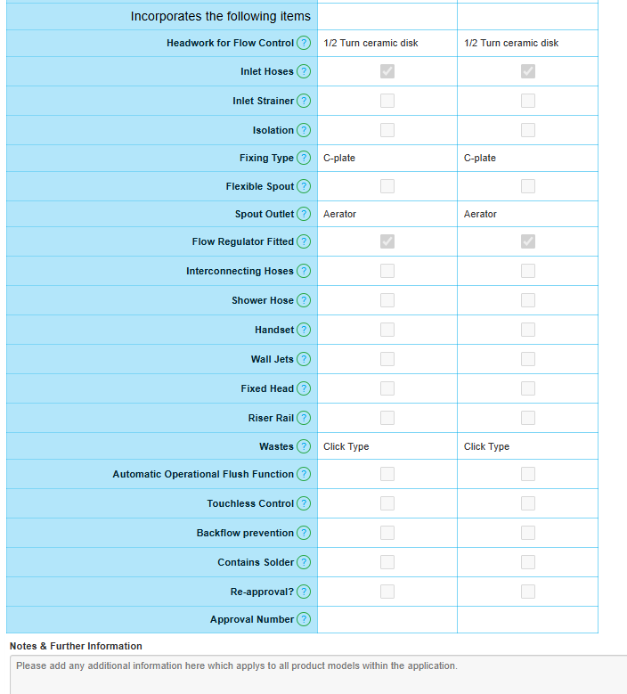
Product Details – Direct data input
Complete for each product that incorporates the following items:
Headwork for Flow Control - Does the product, a tap for example, incorporate headworks. These are valves that control the flow of water from the inlet(s) to the outlet(s). Types of headworks typically include, but are not limited to, 'ceramic cartridge', ‘ceramic disc’, 'rising/non-rising spindle' or 'self-closing’.
  Please note, servicing or isolation valves are not considered as headworks.
Inlet Hoses - Tick this box if the product includes inlet hoses
Inlet Strainer - Tick this box if the inlet(s) includes strainer(s)
Isolation - Does the product incorporate a component that can isolate the product, typically at the inlet(s), for example a spherical (ball) valve that can be utilised the shut off flow to product for the purpose of maintenance/servicing. Please note, headworks or operating valves are not considered isolation valves.
Fixing Type - Does your product incorporate a fixing device to fix the product to a surface. Please select from the drop-down list.
Flexible Spout - Tick the box if the spout of the tap includes a pull out or pull-down hose.
Spout Outlet - Select from the drop down list the type of outlet fitted/supplied with the tap.
Flow Regulator Fitted - Does the product incorporate a device that regulates the flow of water to ensure it does not exceed a prescribed flow rate irrespective of the supply pressure.
Interconnecting Hoses - Tick the box the tap is supplied with interconnecting hoses for use between the flow or temperature control device and the spout
Shower Hose - Tick the box if the product is supplied with a shower hose.
Handset - Is the product supplied with a handset outlet, for example, a shower handset.
Wall Jets - Tick the box if the product is supplied with wall jets
Fixed Head - Tick the box if the product is supplied with a fixed shower head
Riser Rail - Tick the box if the product is supplied with a riser rail
Wastes - is the product supplied with or incorporates a device that controls the wastewater outlet. please list the type of waste supplied. For example, a click type or lever operated pop-up waste.
1
2
3
5
4
6
7
8
9
10
11
12
13
14
15
Continued on the next page

Slide 10
Product Details – Direct data input
Complete for each product, that incorporates the following items:
Automatic Operational Flush Function - If the product incorporates a hygienic flush cycle function, typically found in non-touch method (infra-red sensor) type taps, please select this field and fill in the F7 form
Touchless Control - Does the product incorporate a flow control device that is controlled by a non-touch sensor or remote control. For example, a tap that has a solenoid valve to control the flow of water, where on/off is controlled by an infra-red sensor (IR sensor) or where the control is hand operated but remotely controls the flow function. For example, turning a control manually triggers an electrical signal to operate the flow control device.
Backflow Prevention - Backflow is defined as the flow upstream, that is in a direction contrary to the intended normal direction of flow, within or from a water fitting. A backflow protection device is a device used to prevent backflow appropriate to the highest applicable fluid category to which the fitting is subject downstream before the next such device. Examples of backflow devices or arrangements types are, but not limited to, check valves or airgaps.
  Does the design incorporate a backflow prevention device / arrangement, such as a check valve or airgap? If you incorporate a component in your design and its arrangement appears to form of backflow protection WRAS will expect it to be tested unless you select NO.
  Please note:
  Non-return valves (NRV's) are not considered to be back-flow prevention devices .
  The gap that can be created between the spout and the spill over level of the sink/bath should not be considered as a backflow protection device.
Contains Solder - If the product incorporates the use of solder for its construction, please confirm with a tick (yes) here.
Re-approval? - Is this application a reapproval of an existing or a recently expired WRAS approval?
Approval Number - If this application is a re-approval, please provide the current/expired approval number.
Notes & Further Information – Please include any details that will enhance the product description for display on the online portal. You may also use this section to provide additional information to support your application, these supporting details will not be shown online but will be retained in the assessor’s notes.
1
2
3
4
5
6
7

Slide 11
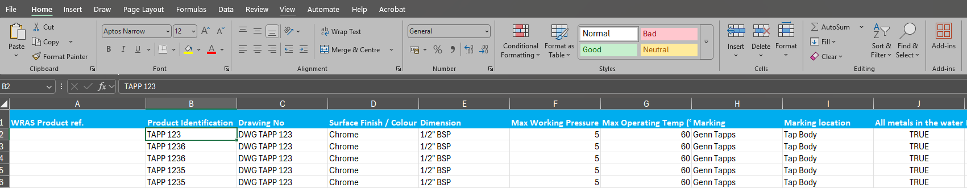
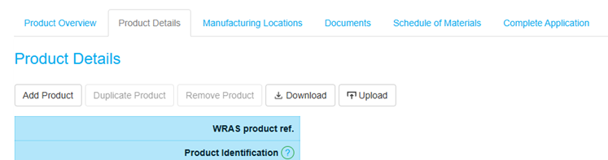
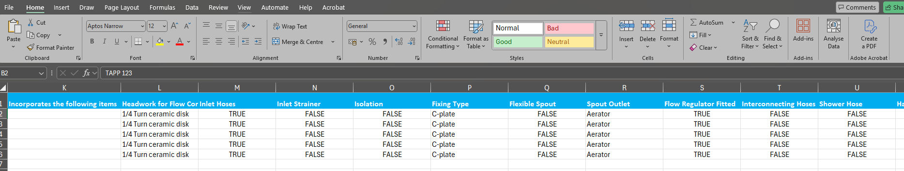
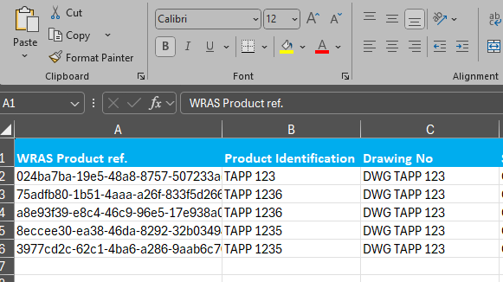
Product Details – Offline Upload
Follow the steps
Download the Excel spreadsheet
Complete excel spreadsheet
  Ensure the Excel sheet matches the structure and content of the manual entry version ‘Direct data input’ Version as a Reference on pages 8 – 10.
  All required fields must be completed as they would be in the manual system.
  Ensure Data Completeness, every required field must have a value. Double-check that no mandatory fields are left empty unless specified.
  Use ‘True’ or ‘False’ where there is a tick box in the ‘Direct data input’ version.
Upload the excel spreadsheet
WRAS Product ref. is an auto-generated Unique Identification ID. Once the details are completed and the form is downloaded, this ID must not be edited before uploading.
2
1
3
2
4

Slide 12
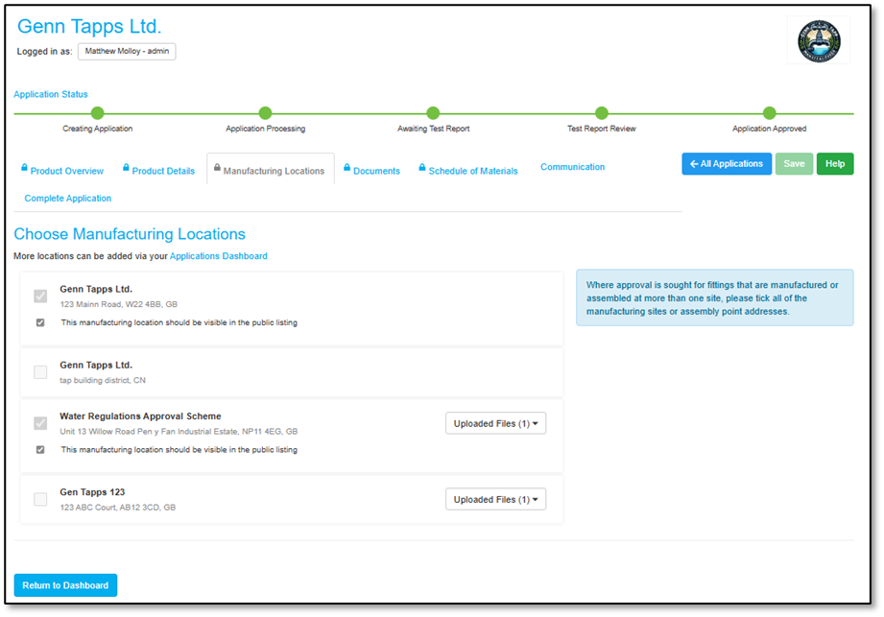
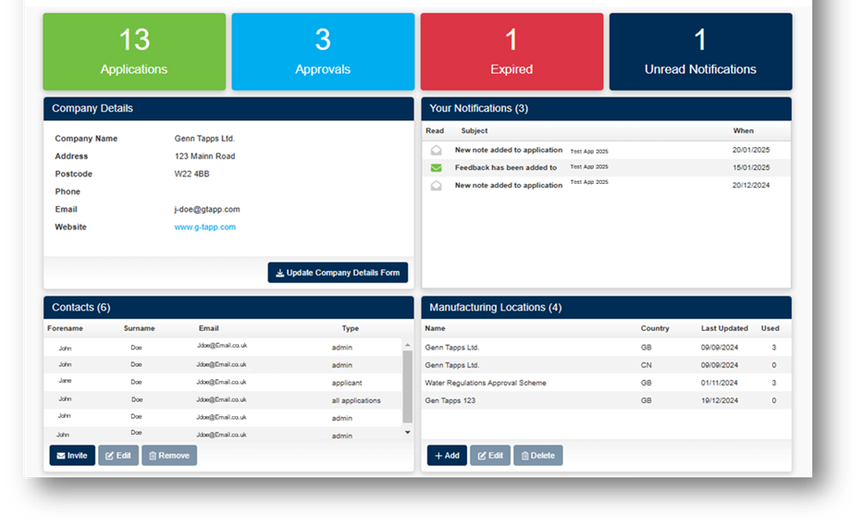
Manufacturing Locations
Choose Manufacturing location(s)
A manufacturing location is defined as the final assembly location.
Select all Manufacturing sites and locations relevant to the application.
Choose whether they should be visible on the public listing.
  If the marking refers to the manufacturer they must be listed publicly for traceability.
If a required manufacturer is not listed, add them by returning to the main dashboard
Select ‘+Add’ to add new manufacturer, see page 13
1
2
3
4

Slide 13
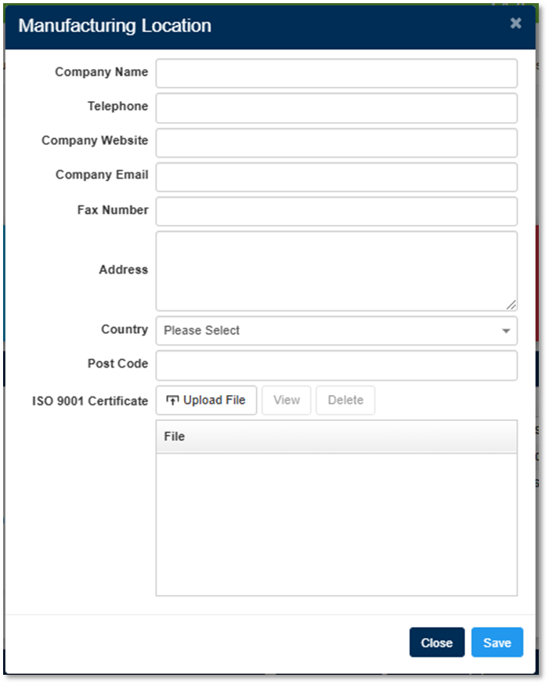
Manufacturing Locations - New manufacturer
1
New Manufacturer
Complete the details below:
Company Name – Registered name of the manufacturing location.
Telephone – Contact number for the manufacturing site.
Company Website – Web address of the manufacturer.
Company Email – General company email (specific contacts are stored elsewhere).
Fax Number – Include if applicable.
Address – Specific address of the manufacturing site.
Country – Select the country of the manufacturing site.
Post Code – Also known as ZIP code, CAP, Eircode, or Postal Index Number (PIN).
ISO 9001 Certificate - Upload proof of a Quality Control Management System (QMS), such as:
  An ISO 9001 or equivalent certificate.
  If unavailable, a copy of the Factory Production Control (FPC) documentation.
2
3
4
5
6
7
8
9

Slide 14
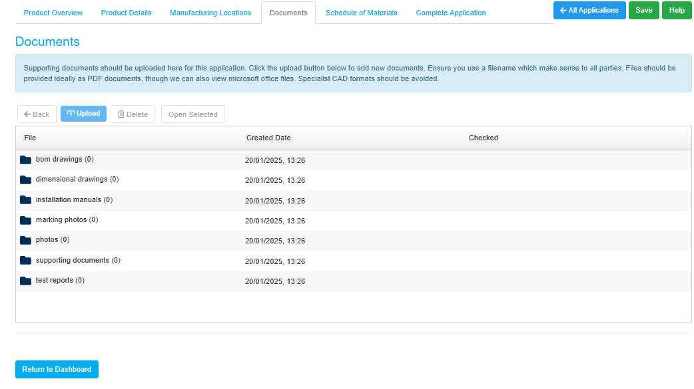
Documents
Documents
The document page contains multiple folders. Some documents are mandatory for submission, while optional ones may assist the assessor in processing your application.
Mandatory Documentation
BoM Drawings – Itemised drawings used to verify the supplied SoMs.
Photos – Product photos, must show all items included 'in the box'.
Marking Photos – Clear images or drawings of product markings and location.
  (accepted formats: JPEG, PNG, PDF).
  Additional Documentation
Supporting Documents – Any files that help with the assessment.
Installation Manuals – Must be specific to the models in the application.
Dimensional Drawings – General product dimensions.
Test Reports – Upload BS6920 evidence or any relevant cross-referenced test reports.
  Confidential Information
If you require your component manufacturer to submit confidential information, it must be sent directly to info@wrasapprovals.co.uk, clearly quoting the relevant WRAS application reference number (WA******) once the application has been submitted.
1
6
5
3
2
4
7

Slide 15
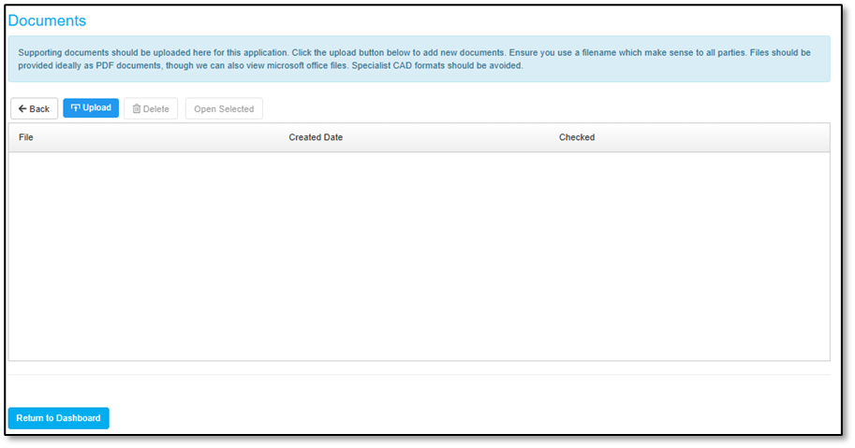
Documents - Uploading files
Uploading Documents
Open the required Folder
Before uploading, navigate to and open the folder where you want to store the documents.
Uploading is only possible once the correct folder has been selected and opened.
Uploading Methods
Once your folder is open, you have two options to upload your files:
Upload Button
  Click the Upload button.
  This will open your file explorer.
  Locate and select the files you wish to upload.
  Click Upload to add them to the folder.
Drag & Drop
  Simply drag the files from your computer.
  Drop them into the designated upload area.
  The files will be added to the folder automatically.
A
Drop here
B

Slide 16
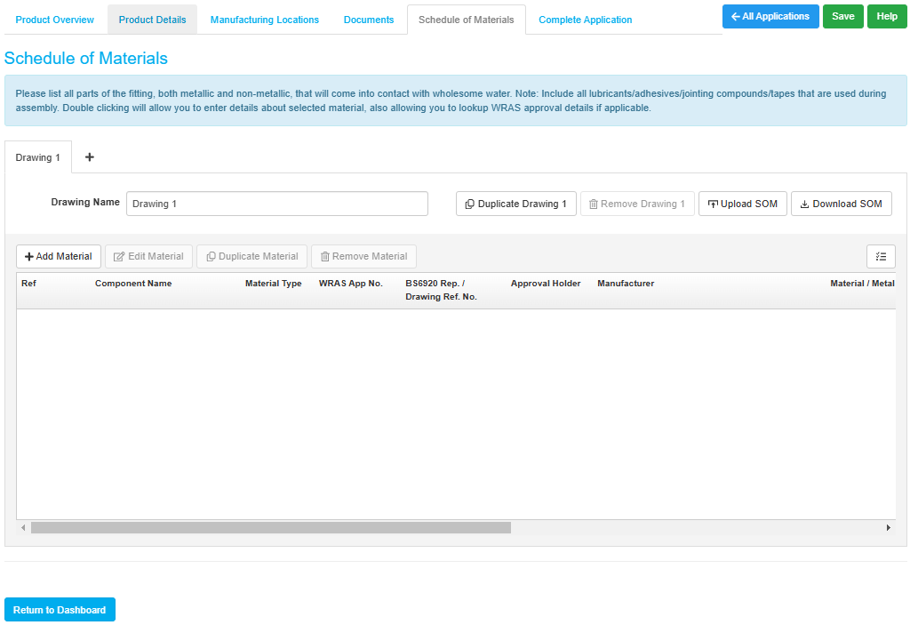
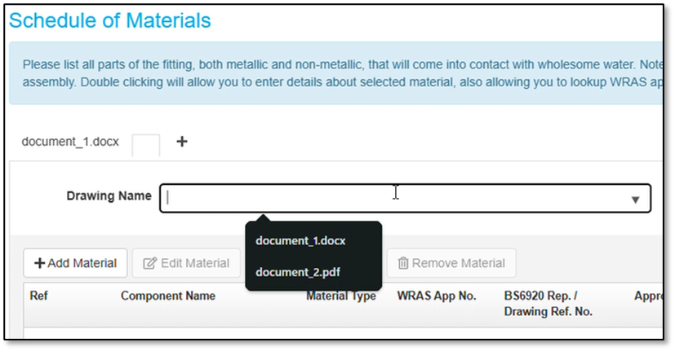
Schedule of Materials (SoM)
Key
+ symbol – Generates a new SoM, a SoM is required for every BoM drawing
Drawing Name – The SoM must be named the same as your uploaded ‘BOM drawing’.
Duplicate ‘Drawing Name’ – Create a duplicate of the completed SoM
Remove ‘Drawing Name’– Delete the selected SoM
Download SOM – Download an excel file to complete product SoM
Upload SOM – Upload the completed SoM
  Ensure you use only the SoM downloaded from this page as other versions will not work with this feature.
View Options – Edit the online display of the SoM
Editing the SoM
+ Add Material – Adds new lines for completion.
Edit Material – Opens the details window for editing (or double-click a line to edit).
Duplicate Material – Duplicates a material line if used multiple times.
Remove Material – Deletes selected lines if needed.
1
6
3
4
5
2
7
A
B
C
D
Drawing Name
To ensure accuracy, link the drawing to the SoM using the provided drop-down box. Since all documents are uploaded, simply clear the bar and start typing the drawing number to find the correct one.
As shown in the image, the document uploaded in the ‘BOM drawing’ folder can now be linked to each SoM, ensuring accuracy in the assessment process.

Slide 17
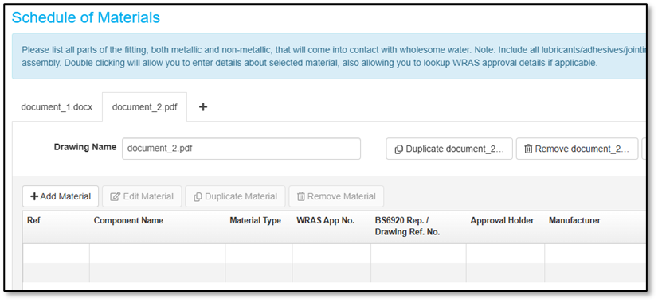
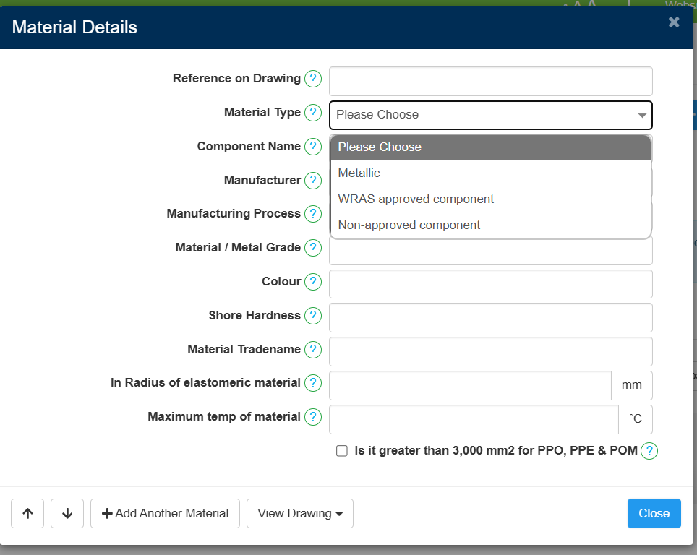
Schedule of Materials (SoM) – Direct data input
Manually Completing the SoM
Follow the following steps to complete the details in the SoM
+ Add Material - to start completing the SoM.
Edit - Double-click a line or highlight the line and click ‘Edit Material’
Material details – Window will open
Select your ‘Material Type’:
  Metallic – For any metal component in contact with wholesome water.
  WRAS Approved Component – For materials or components with WRAS approval.
  Non-Approved Component – For unapproved materials or components (must include BS6920 evidence for compliance).
Control Arrow – Scroll between lines of the SoM.
+ Add Another Material – Add a new line on the SoM.
View Drawing – Open the drawing that is referenced in the SoM.
1
2
3
4
5
6
7

Slide 18
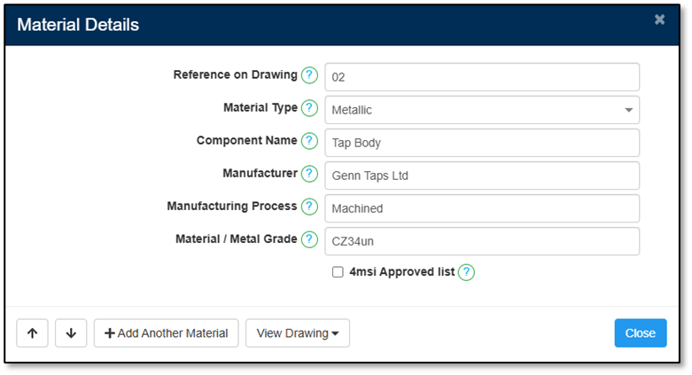
Schedule of Materials (SoM) - Metallic
Reference on Drawing - Each drawing that is used to illustrate your product should have a unique drawing number/name. Please insert this number/name. This number should relate to a corresponding SoM, that should be assigned the same number/name.
Material Type - Please select from the dropdown the appropriate component type for each component.
Component Name - Provide the component with a very short description of what it is. For Example, O-ring, spring, spout, cartridge etc.
Manufacturer - Please provide the name of the manufacturer of the individual component.
Manufacturing Process - Please provide detail on how the component is manufactured. For example, extruded, compression moulded, cast, forged and so on.
Material / Metal Grade - Please provide the specific grade of material for each component for both metallic and non-metallic components. (not applicable if an assembled product, such as a headwork). If metallic, this is typically a unique code/name, such as CW617N (brass). If non-metallic, this is typically the tradename of the specific material. Please note, if the product has a component, such as the body, that is encapsulated in a coating, such as an epoxy resin, the internal body material, cast iron for example, will need to be listed separately from the coating.
4msi Approved list -There isn’t a UK requirement for metals to be on the European positive list of metals. Not using these metals will not prevent an approval from being granted. If all metals in the water pathway are declared as being on the European positive list a statement will be added to the approval. Tick the box if the metal used appears on the European positive list of metals.
1
2
3
4
5
6
7

Slide 19
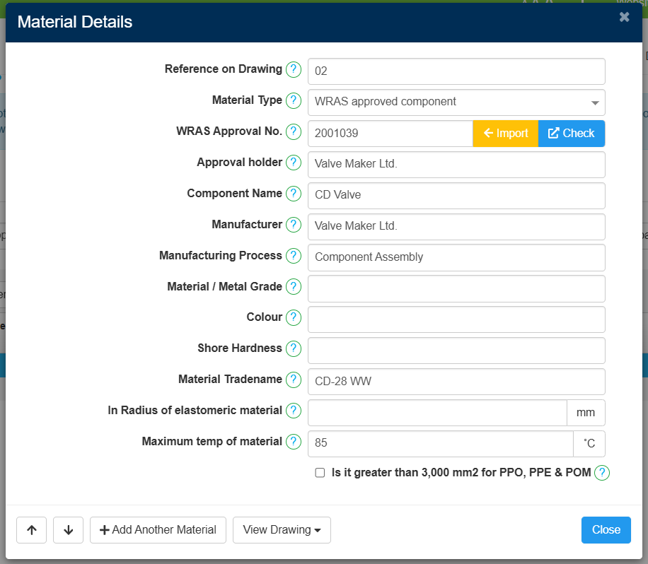
Schedule of Materials (SoM) - WRAS Approved Component
Reference on Drawing - Each drawing that is used to illustrate your product should have a unique drawing number/name. Please insert this number/name. This number should relate to a corresponding SoM, that should be assigned the same number/name.
Material Type - Please select from the dropdown the appropriate component type for each component.
WRAS Approval No - If the component has a current & valid approval number, please provide this.
Approval holder - Please detail the approval holder of the WRAS approved component. You can import this if you have provided an approval number.
Component Name - Provide the component with a very short description of what it is, for Example, O-ring, spring, spout, cartridge etc.
Manufacturer - Please provide the name of the manufacturer of the individual component.
Manufacturing Process - Please provide detail on how the component is manufactured, for example, extruded, compression moulded, cast, forged and so on.
Material / Metal Grade - Please provide the specific grade of material for each component for both metallic and non-metallic components (not applicable if an assembled product, such as a headwork). If metallic, this is typically a unique code/name, such as CW617N (brass). If non-metallic, this is typically the tradename of the specific material.
  Please note, if there is a component within the product which is coated, please include details of both the base material and the coating.
Colour - Please provide the colour of the component used, if appropriate.
Shore Hardness - If the component is elastomeric, such as EPDM or silicone, it will have a specific shore hardness rating.
Material Tradename - Please supply the specific tradename for the material/component.
In-radius of elastomeric material - if the material is elastomeric the in-radius needs to be included. Information on this can be found on page 4 of guidance document for non-metallic materials.
Maximum temp of material - State the maximum temperature the material can be used at. This relates to its limitations for BS6920.
PPO, PPE or POM material - if it exceeds 3,000 mm² you must indicate this using the tick box provided.
1
2
3
4
5
6
7
8
9
10
11
12
13
14

Slide 20
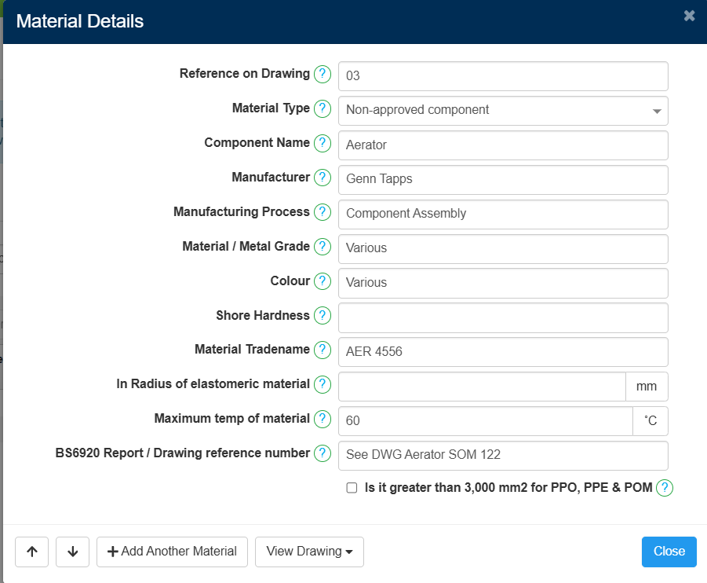
Schedule of Materials (SoM) - Non-Approved Component
Reference on Drawing - Each drawing that is used to illustrate your product should have a unique drawing number/name. Please insert this number/name. This number should relate to a corresponding SoM, that should be assigned the same number/name.
Material Type - Please select from the dropdown the appropriate component type for each component.
Component Name - Provide the component with a very short description of what it is, for Example, O-ring, spring, spout, cartridge etc.
Manufacturer - Please provide the name of the manufacturer of the individual component.
Manufacturing Process - Please provide detail on how the component is manufactured, for example, extruded, compression moulded, cast, forged and so on.
Material / Metal Grade - Please provide the specific grade of material for each component for both metallic and non-metallic components (not applicable if an assembled product, such as a headwork). If metallic, this is typically a unique code/name, such as CW617N (brass). If non-metallic, this is typically the tradename of the specific material.
  Please note, if there is a component within the product which is coated, please include details of both the base material and the coating.
Colour - Please provide the colour of the component used, if appropriate.
Shore Hardness - If the component is a non-metallic elastomeric, such as EPDM or silicone, it will have a specific shore hardness rating.
Material Tradename - Please supply the specific tradename for the material/component.
In-radius of elastomeric material - if the material is elastomeric the in-radius needs to be included. Information on this can be found on page 4 of guidance document for non-metallic materials.
Maximum temp of material - State the maximum temperature the material can be used at. This relates to its limitations for BS6920.
BS6920 Report / Drawing reference number - Add the BS6920 test report number that matches the test report. (Upload the test report to the Test Report folder on the documents page). If a sub-component is used add the drawing number for cross referencing
PPO, PPE or POM material - if it exceeds 3,000 mm² you must indicate this using the tick box provided.
1
2
3
4
5
6
7
8
9
10
11
12
13

Slide 21
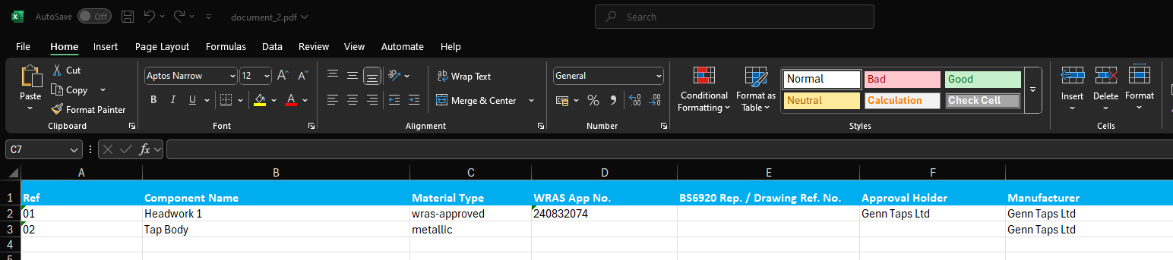
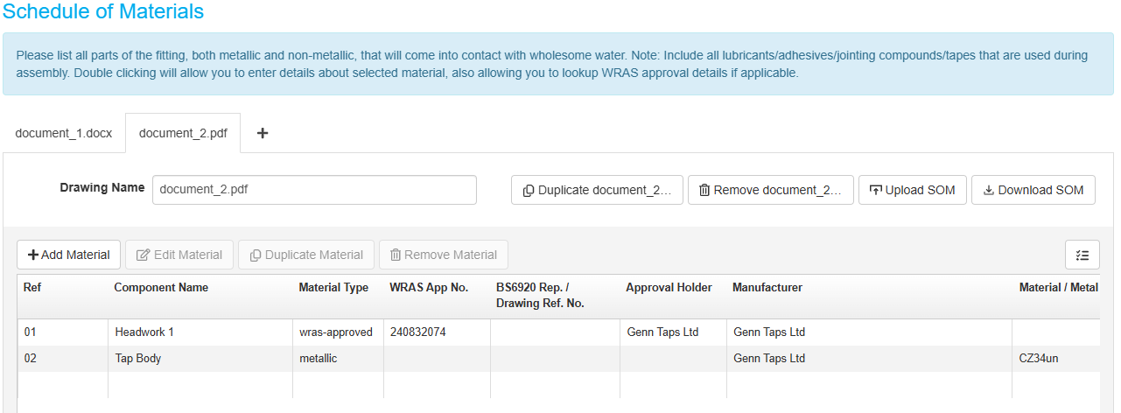
Schedule of Materials (SoM) – Offline upload
Offline Completing the SoM
Download the Excel spreadsheet
Complete excel spreadsheet
  Ensure the Excel sheet matches the structure and content of the manual entry version ‘Direct data input’ Version as referenced on pages 17 – 20.
  All required fields must be completed as they would be in the Direct data input.
  Use True or false where there is a tick box in the ‘Direct data input’ version.
Upload the excel spreadsheet
Separate TAB, each individual SoM will need a separate upload.
Completed SoM
3
4
2
1
5

Slide 22
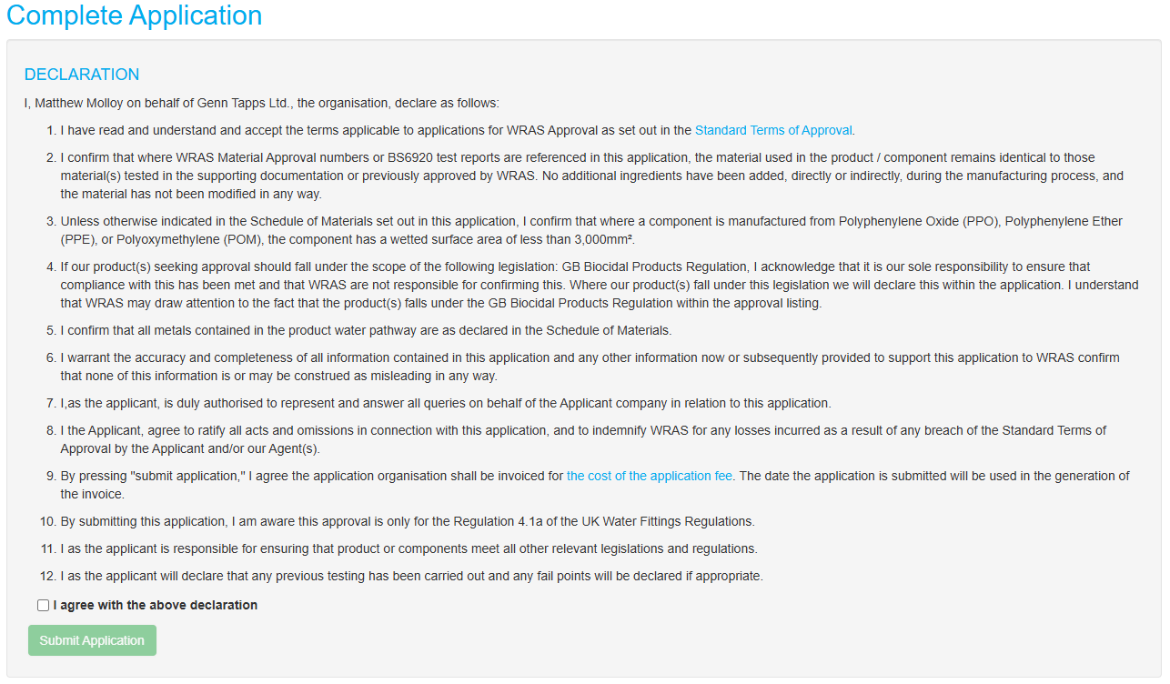
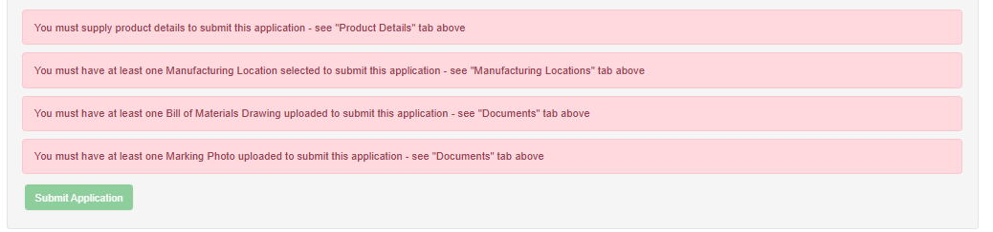
Complete Application
Completing the Application
Review & Agree – Tick the box to confirm your agreement with the declaration.
Submit Application – Click the "Submit" button to finalise your application.
Error Message – If any issues are detected before submission, they must be corrected before the application can be successfully submitted.
1
2
3

Slide 23
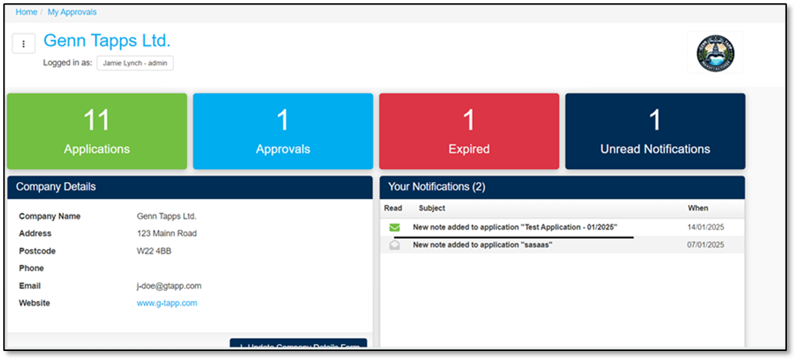
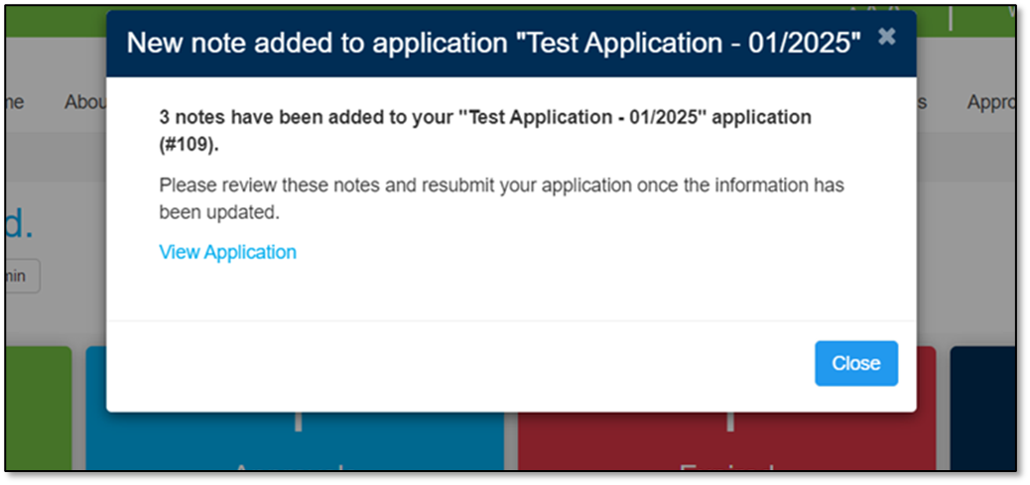
Application Review - Notifications
1
Reviewed Application
Once the application has been reviewed, any queries or issues will be highlighted for your attention.
Your Notifications – Available on your Approvals Dashboard, notifications related to your application will appear.
New Note - Selecting a notification will open a New Note window, which includes a link to the application for further review and action.
2

Slide 24
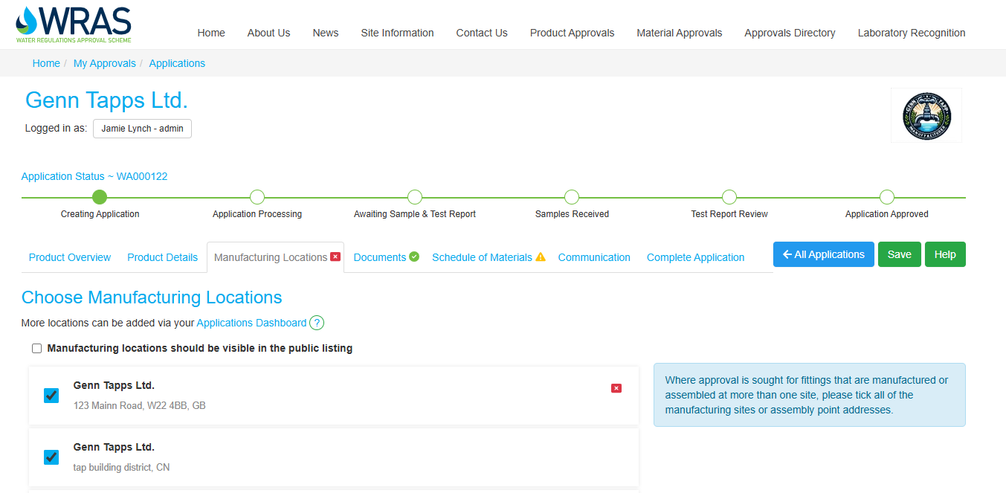

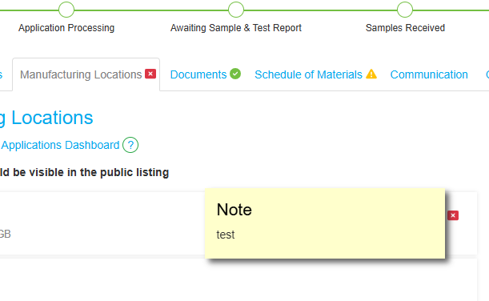
Application Review - Assessor Feedback
Reviewing Assessor Feedback
After clicking the link in the ‘New Note’ box, you will be directed to the relevant approval.
Throughout the application, you will see coloured shapes indicating different statuses:
*Red Box – A query or issue has been raised by the assessor.
*Amber Triangle– You have responded to the query or issue.
*Green Circle – The assessor has reviewed your response and marked the issue as resolved.
– No issues were found in this section, and it is locked from editing.
Wherever you see a Red Box, there is a comment from the assessor.
Clicking on the asterisk will open a ‘sticky note’ style message.
If you need further clarification or wish to respond, you can do so via the communication window.
Once you’ve addressed all comments and made the necessary updates, you must resubmit your application using the ‘Complete Application’ tab. Your assessor will not be notified to review your changes unless you do this.
If you make changes to a section where a note was placed, the Red Box will change to an Amber Triangle.
2
3
1

Slide 25
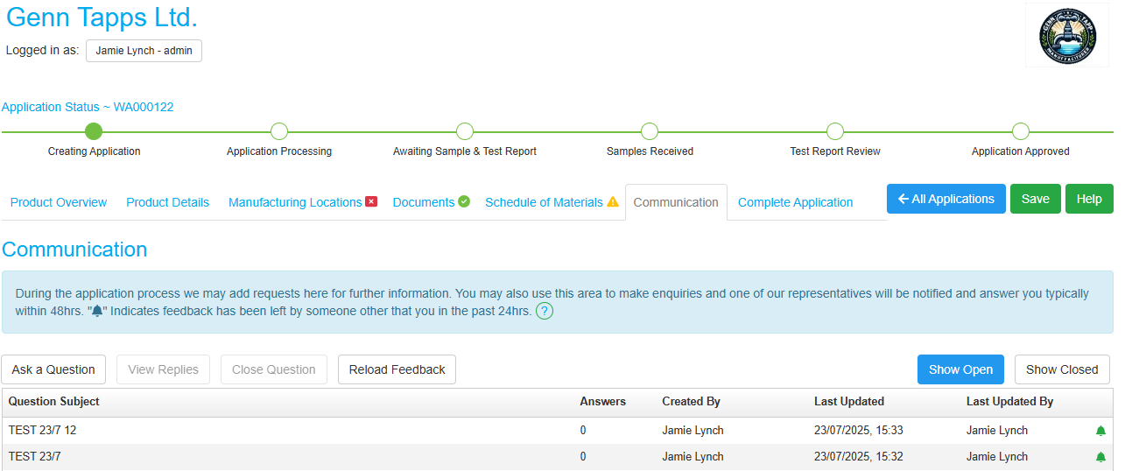
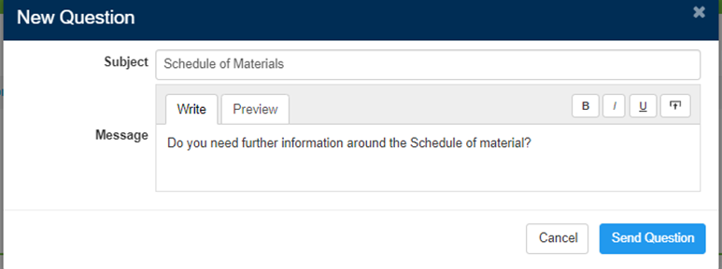
Application Review - Communication
Communication
Communications Tab - will only become available once the application has been assigned to an assessor.
    Contacting the Assessor
  Ask a Question – can be used to contact the WRAS assessor responsible for your application.
  Subject - messages are required to have a title to enable sending a communication.
  Message - the subject must be relevant to the application and comply with WRAS impartiality guidelines.
  Upload – documents can be uploaded when you ask a question
A
1
4
2
3

Slide 26
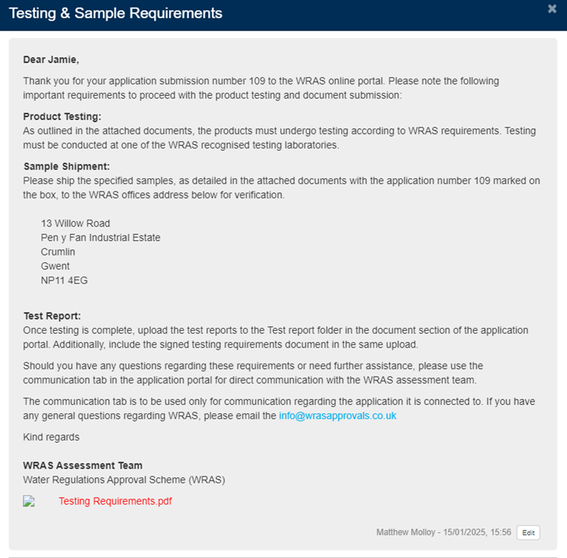
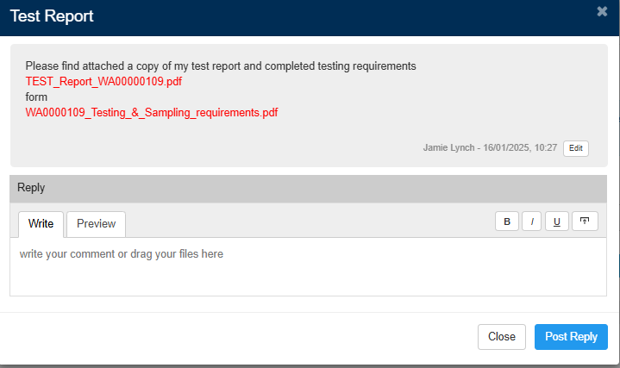
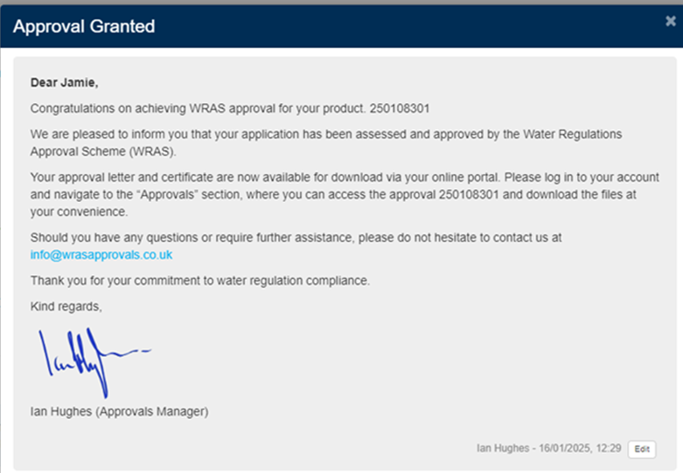
Application Review - Communication
Important Communication
Throughout the WRAS application process, several key types of communication will be used to keep you informed and guide you through each stage:
Testing & Sample Requirements
  Once your application has been reviewed and any queries resolved, you will receive communication detailing the testing and sample requirements.
  The document outline sample to be tested at a WRAS recognised laboratory.
  You must send requested samples to WRAS
  A response is required to confirm whether you will collect the samples after approval or if WRAS should dispose of them on your behalf.
Submitting Test Reports
  After testing is complete at your chosen recognised laboratory, you must communicate your results by uploading the test report via the communication function.
  Once reviewed, the assessor will confirm completion and move the report to the test report folder.
Decision & Approval Notification
  Once the test report has been reviewed, the assessor will identify the next steps and submit the application to a decision maker if appropriate.
  You will receive a final approval notification once the decision maker confirms that all WRAS criteria have been met.
  You will be able to view and download your approval documents in my approvals section on the portal.
1
2
3

Slide 27
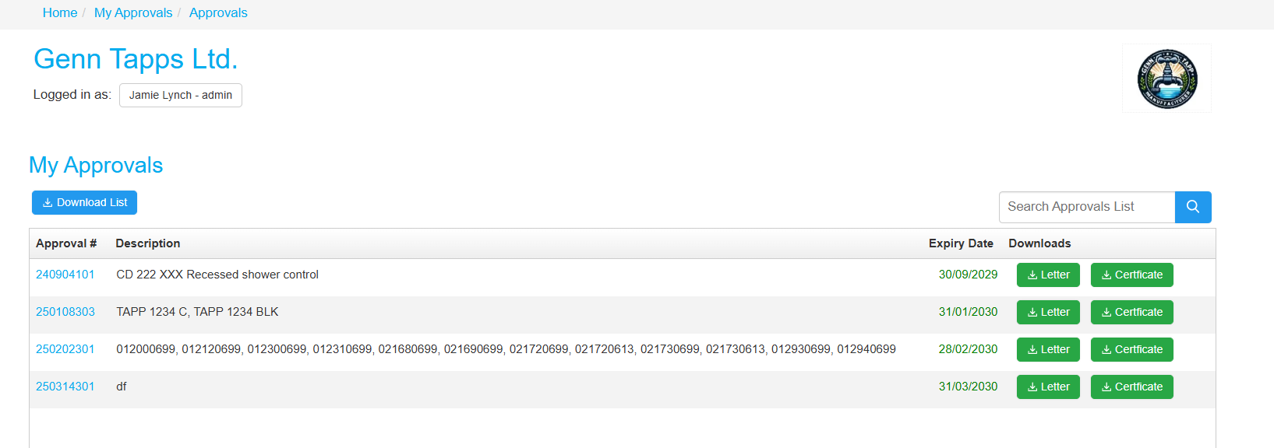
My Approvals
Key
Download List - Export all approval into an Excel document.
Approval # - list of all your approval numbers, click on the number to take you to the online listing.
Description – the model number as displayed on the certificate.
Expiry date – the date which the approvals expire, colour coded
  Red – Expires within 3 months
  Amber – Expires with 9 months
  Green – All other valid approvals
Letter – Download your approval letter
Certificate – Download your certificate
1
4
5
6
2
3

